Slide 1
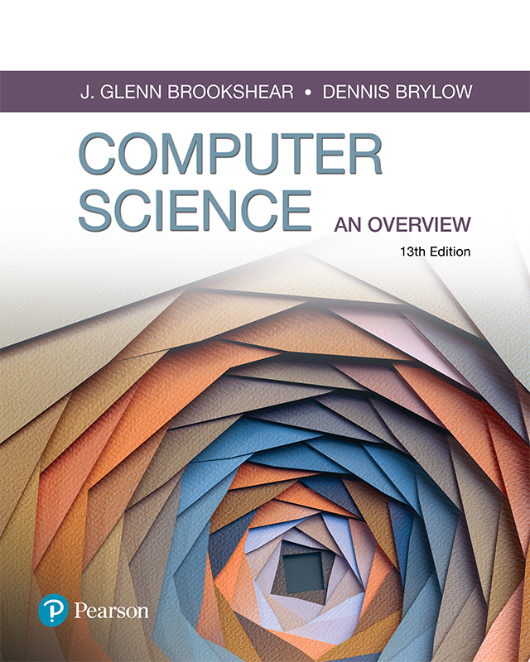
Computer Science An Overview
13th Edition
Chapter 1
Data Storage

Slide 2
Chapter 1: Data Storage
Video 1 (slides 1-18)
Boolean/Bit Logic
Logic Gates, Flip Flops
Video 2 (slides 19-31)
Bit Storage in Memory
Bit Representation – Text, Numbers, Images, Sounds
Video 3 (slides 32-42)
Numbering Systems – Binary, Decimal, Hexadecimal
The Binary System and Binary Addition
Video 4 (slides 43-54)
Storing Integers, Fractions in Binary
Negative Numbers and 2’s Complement
Excess Notation

Slide 3
Bits and Their Storage
Bit: Binary Digit (0 or 1)
Bit Patterns are used to represent information
Numbers
Text characters
Images
Sound
And others

Slide 4
Gates
Gate: A device that computes a Boolean operation
Often implemented as small electronic circuits called transistors
Can be constructed from a variety of other technologies
Provide the building blocks from which computers are constructed

Slide 5
Boolean Operations
Boolean Operation: An operation that manipulates one or more true/false values
Specific operations
AND – both operands must be true for the result to be true
OR – one or both operands must be true for the result to be true
XOR (exclusive or) – one or the other (but not both) of the operands must be true for the result to be true
NOT – result will be negation of the operand (if operand is true, result will be false and vice-versa)
NAND – negates an AND operation (NOT (AND))
NOR – negates an OR operation (NOT (OR))

Slide 6
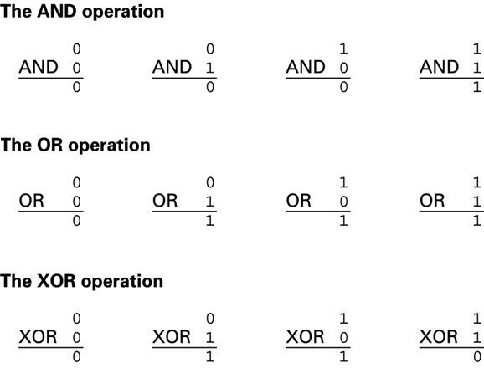
The possible input and output values of Boolean operations AND, OR, and XOR (exclusive or)
Notes:
The AND operation
The OR operation
The XOR operation

Slide 7
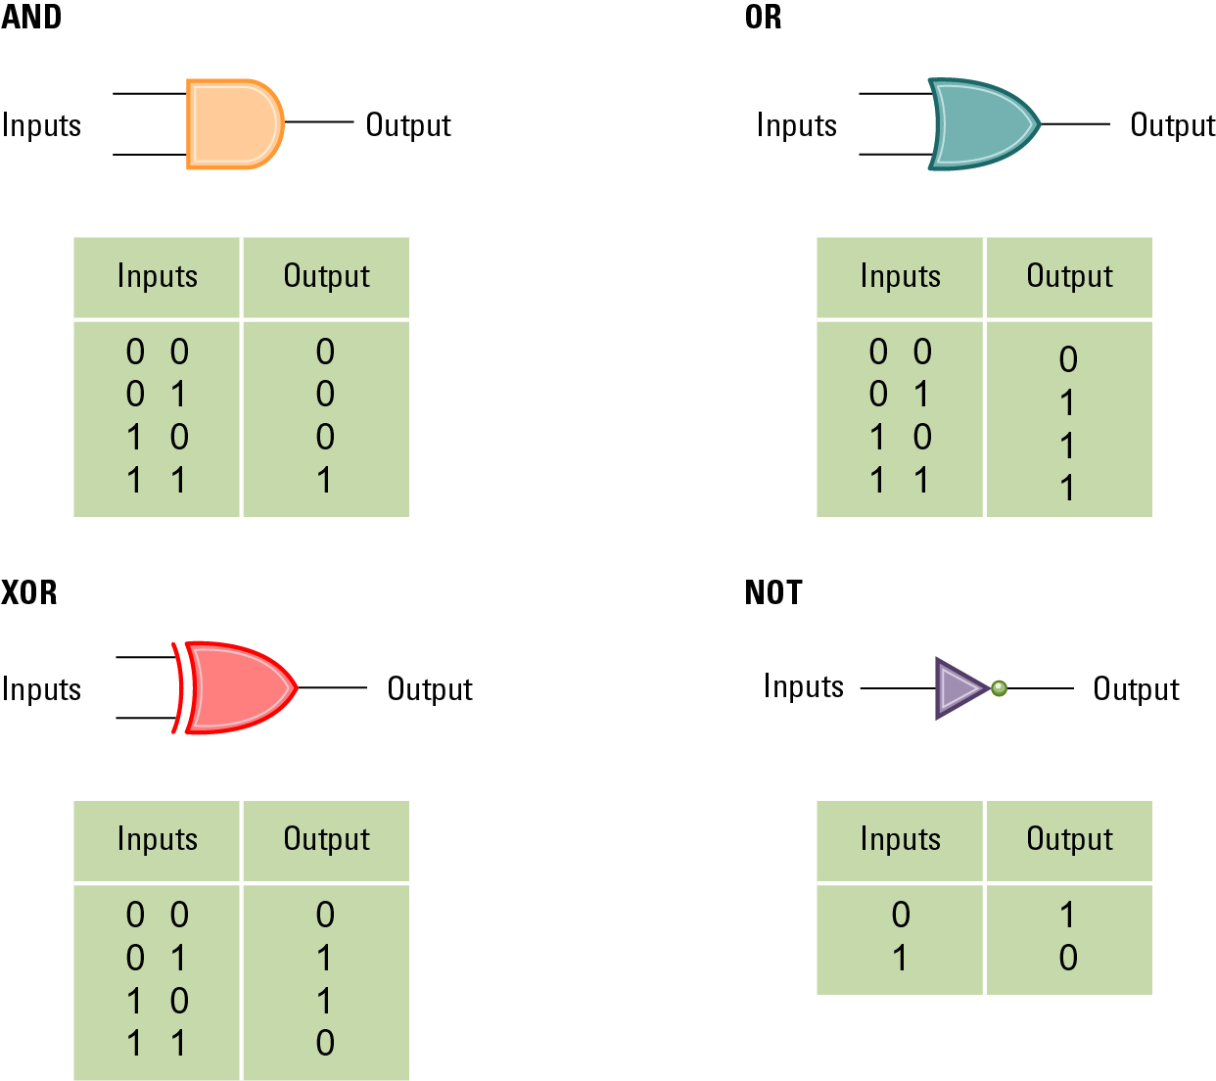
A pictorial representation of AND, OR, XOR, and NOT gates as well as their input and output values

Slide 8
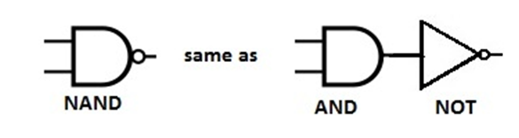
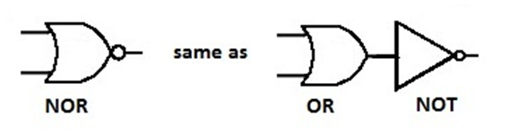
NAND and NOR Gates
A | B | A AND B | A NAND B NOT (A AND B)
0 | 0 | 0 | 1
0 | 1 | 0 | 1
1 | 0 | 0 | 1
1 | 1 | 1 | 0
A | B | A OR B | A NOR B NOT (A OR B)
0 | 0 | 0 | 1
0 | 1 | 1 | 0
1 | 0 | 1 | 0
1 | 1 | 1 | 0

Slide 9
Additional Notes on Boolean Logic
More than 2 inputs - the principles remain the same regardless number of inputs:
OR – at least one input must be true for output to be true
AND – all inputs must be true for output to be true
XOR – at least one (and only one) input must be true for output to be true
NAND – compute the AND of all inputs first, then compute the NOT of that result
NOR – compute the OR of the all inputs first, then compute the OR of that result
Example:
A | B | C | A OR B OR C
0 | 0 | 0 | 0
0 | 0 | 1 | 1
0 | 1 | 0 | 1
0 | 1 | 1 | 1
A | B | C | A OR B OR C
1 | 0 | 0 | 1
1 | 0 | 1 | 1
1 | 1 | 0 | 1
1 | 1 | 1 | 1

Slide 10

Additional Notes on Boolean Logic
Combining logic operations – start with parentheses and work your way out:
(A AND B) OR C
A | B | C | A AND B | (A AND B) OR C
0 | 0 | 0 | 0 | 0
0 | 0 | 1 | 0 | 1
0 | 1 | 0 | 0 | 0
1 | 1 | 1 | 1 | 1

Slide 11
Additional Notes on Boolean Logic
AND or OR for 8-bit Binary Numbers
AND or OR each column individually to get the result.
Same method can be applied to other logic gates: XOR, NOR, NAND, etc.
Example:
AND: OR:
11001010 11001010
01010110 01010110
01000010 11011110
NOTE: This is not the same as adding binary numbers. This is applying AND, OR , and other Boolean logic to 2 binary bit representations. We will cover binary addition later in this lecture.

Slide 12
Flip-flops
Circuits built from gates that act as a fundamental unit of computer memory
One input line is used to set its stored value to 1
One input line is used to set its stored value to 0
While both input lines are 0, the most recently stored value is preserved
Flip flops ensure that bit storage values in computer memory can change, or “flip flop” between 0 and 1 based on inputs received.

Slide 13
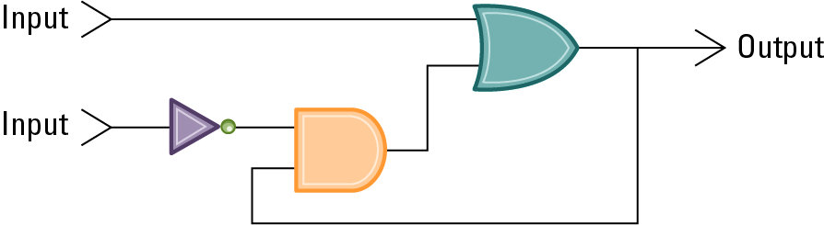
A simple flip-flop circuit

Slide 14
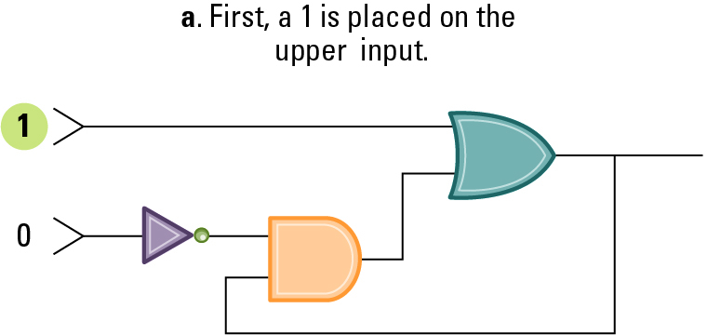
Setting the output of a flip-flop to 1

Slide 15
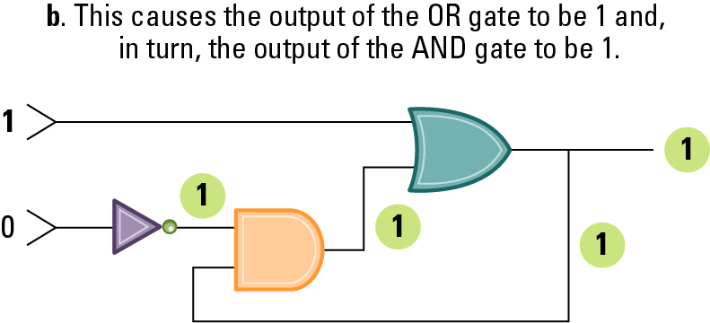
Setting the output of a flip-flop to 1 (continued)

Slide 16
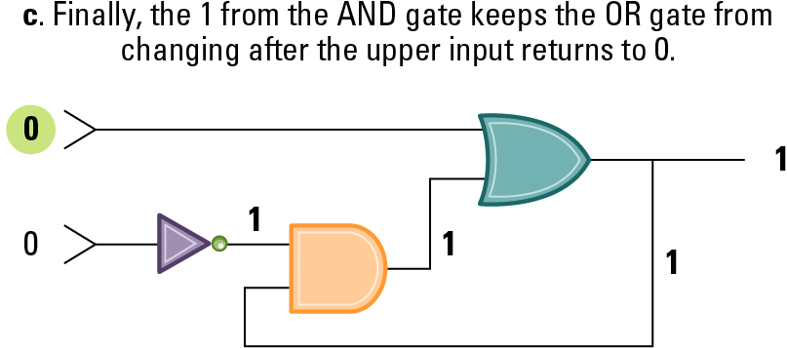
Setting the output of a flip-flop to 1 (continued)
This ensures the only way to change (or flip) the output value to 0 is for the bottom input to come in as 1.As long as the upper input stays at 0 or flips back to 1, the output will still be a 1.

Slide 17
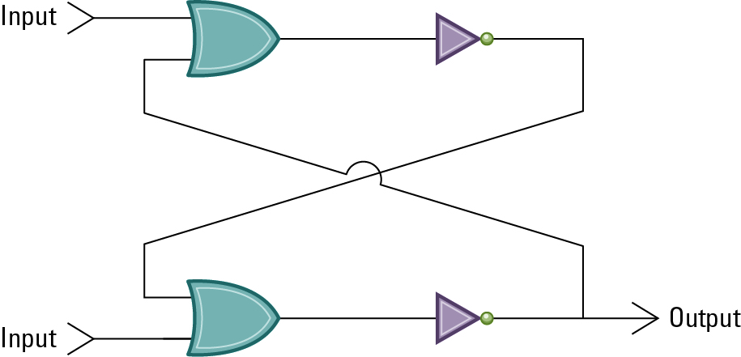
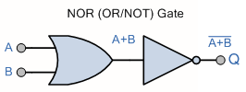
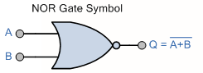
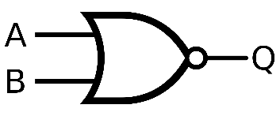
Another way of constructing a flip-flop
=

Slide 18
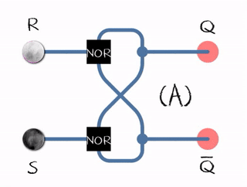
Animation of SR flip-flop
SR – Set/Reset
Black – logical “1”
White – logical “0”
Inputs: S=1,R=0 – “set” or Q=1
Inputs: S=0, R=0 – “hold” (remains at previous output)
Inputs: S=0, R=1 – “reset” or Q = 0
Inputs: S=1, R=1 – not allowed (unstable – keeps repeating without obtaining new inputs)

Slide 19
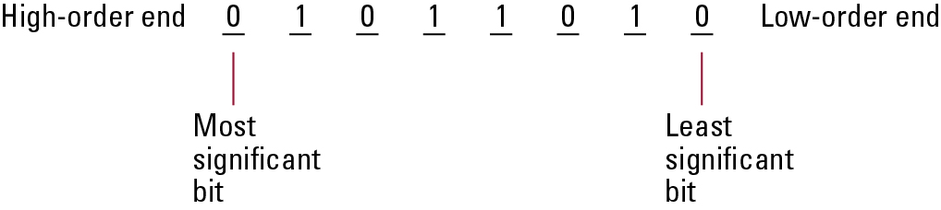
Main Memory
Cell: A unit of main memory (typically 8 bits which is one byte)
Most significant bit (MSB): the bit at the left (high-order) end
Least significant bit (LSB): the bit at the right (low-order) end

Slide 20
Main Memory Addresses
Address: A “name” that uniquely identifies one cell in the computer’s main memory
The names are actually numbers.
These numbers are assigned consecutively starting at zero.
Numbering the cells in this manner associates an order with the memory cells.

Slide 21
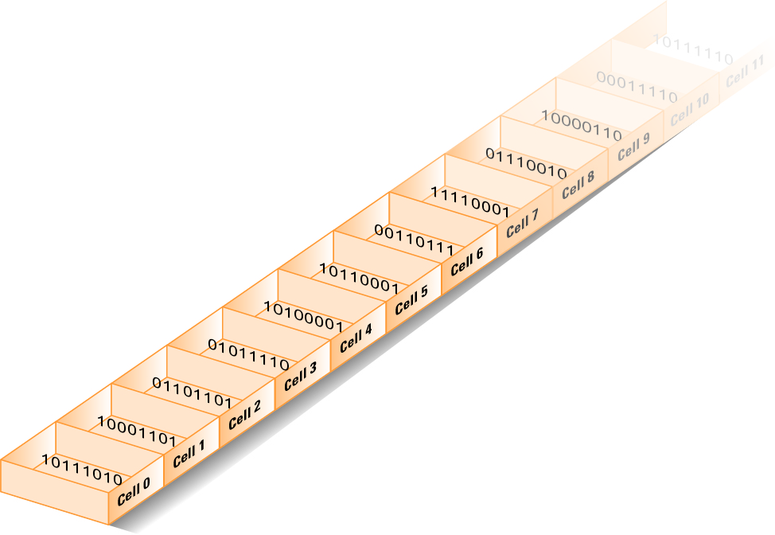
Memory cells arranged by address

Slide 22
Measuring Memory Capacity
Kilobyte: 2¹⁰ bytes = 1024 bytes
Example: 3 KB = 3 times1024 bytes
Megabyte: 2²⁰ bytes = 1,048,576 bytes
Example: 3 MB = 3 times 1,048,576 bytes
Gigabyte: 2³⁰ bytes = 1,073,741,824 bytes
Example: 3 GB = 3 times 1,073,741,824 bytes

Slide 23
Representing Information as Bit Patterns
Many different kinds of information can be encoded as bit patterns
Systems for encoding information have been established for
Text
Numeric Data
Images
Sound
Other data

Slide 24
Representing Text
Each character (letter, punctuation, etc.) is assigned a unique bit pattern.
ASCII: Uses patterns of 7-bits to represent most symbols used in written English text
ISO developed a number of 8 bit extensions to ASCII, each designed to accommodate a major language group
Unicode: Uses patterns up to 21-bits to represent the symbols used in languages world wide, 16-bits for world’s commonly used languages

Slide 25
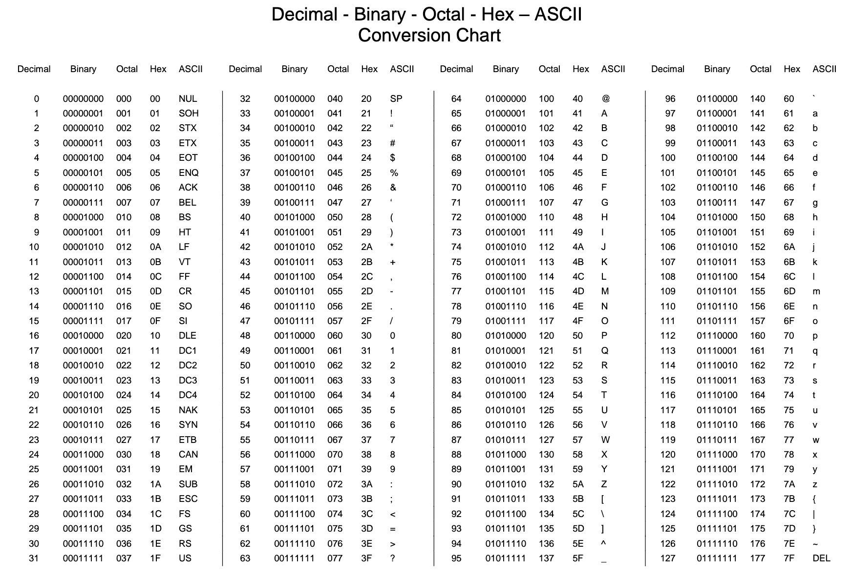

Slide 26
The message “Hello.” in ASCII or UTF-8 encoding

Slide 27
Representing Numeric Values
Binary notation: Uses bits to represent a number in base two
All numeric values in a computer are stored in sequences of 0s and 1s
Counting from 0 to 8:
0000 = 0 0101 = 5
0001 = 1 0110 = 6
0010 = 2 0111 = 7
0011 = 3 1000 = 8
0100 = 4

Slide 28
Representing Images
Bit map techniques
Pixel: “picture element” represents one dot (usually requires 1 byte per pixel)
Common: 1024x768, 1536x864, 1440x900, 1920x1080
RGB: Red, Green, and Blue components (usually requires 3-bytes per pixel)
White: RGB(255,255,255), Black: RGB(0,0,0), Red: RGB(255,0,0), Green: RGB(0,255,0), Blue: (0,0,255), Gray: (128,128,128)
Problems with scaling up bitmap images (JPEG, GIF, PNG, etc.)
When scaling, resolution is not adjusted to best suit the new size, rather pixels are stretched and can appear pixelated or fuzzy.

Slide 29
Representing Images
Vector techniques
Answer to bitmap scaling problem.
Represent images with geometric structures instead of bitmaps.
Using TrueType and PostScript for fonts. Using SVG, WMF, EPS, PDF for graphics.
Both of these techniques make images and fonts more scalable and resolution independent without running into aliasing, pixelating, and fuzziness.

Slide 30
Calculating File Size from Pixels
Problem: Image that is 1024 x 1024 pixels. Each pixel is encoded using 4 bits. What is the size of the image in Megabytes (MB)?
Step 1: = 1024 * 1024 * (4/8) bytes
Step 2: = 2¹⁰ * 2¹⁰ * (4/8) bytes
Step 3: = 2²⁰ * (4/8) bytes
Step 4: = 1 * (4/8) MB
Step 5: = 0.5 MB
Pixels stored as 4 bits out of a single byte, which is 8 bits
Convert pixel height/width to binary exponent
When multiplying x^{y} numbers where x is same, just add their exponents
2²⁰ = 1 MB, replace with a 1.

Slide 31
Representing Sound
“Sampling” records actual audio – number of samples per audio recorded every second, represents acoustic wave value at a specific point in time.
Long-distance telephone: 8000 samples/sec
CD sound: 44,100 samples/sec
The data from each sample is represented as 16 bits (32 bits for stereo recordings). As a result, each second of music recorded in stereo requires > 1,000,000 bits!
MIDI (Musical Instrument Digital Interface) is alternative that requires less storage
Widely used in music synthesizers, electronic keyboards, and video game sound.
Encodes: which instrument, which note, what duration of time.
Clarinet playing the note D for 2 seconds - can be encoded in 3 bytes instead of > 2,000,000 bits when using sampling.

Slide 32
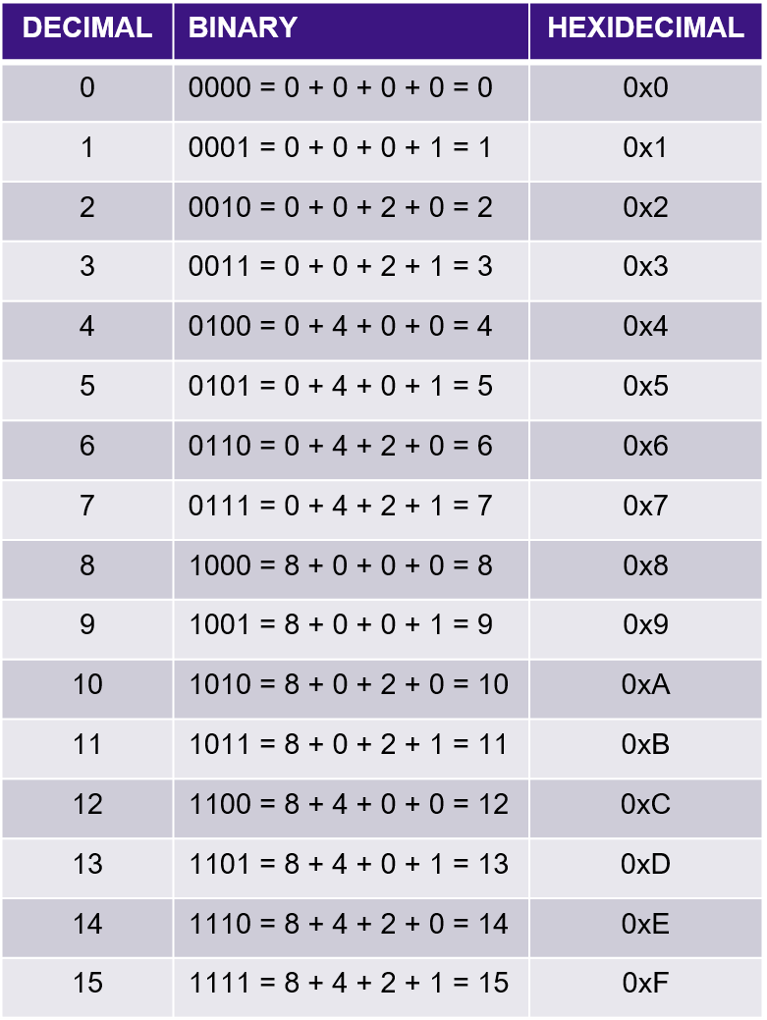
Numbering Systems
Decimal
10³ | 10² | 10¹ | 10⁰
1000 | 100 | 10 | 1
Binary
2³ | 2² | 2¹ | 2⁰
8 | 4 | 2 | 1
Hexadecimal
16³ | 16² | 16¹ | 16⁰
4096 | 256 | 16 | 1

Slide 33
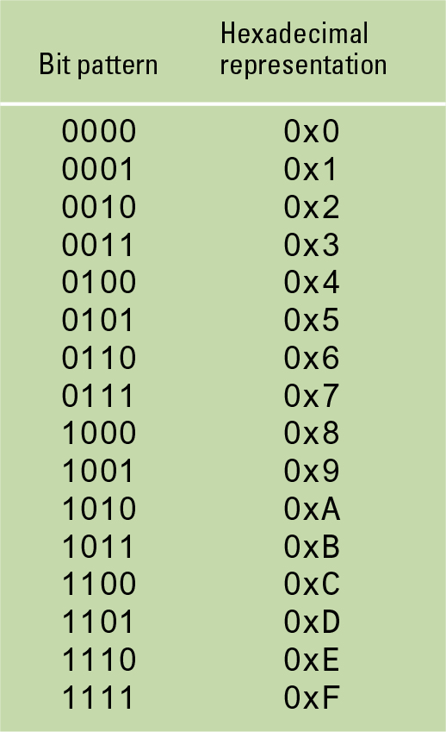
Hexadecimal Notation
Hexadecimal notation: A shorthand notation for long bit patterns
Divides a pattern into groups of four bits each
Represents each group by a single symbol
Decimal Example: 10110101 becomes 0xB5 1011 = 8 + 0 + 2 + 1 = 11 (B) 0101 = 0 + 4 + 0 + 1 = 5

Slide 34
The hexadecimal coding system

Slide 35
The Binary System
The traditional decimal system is based on powers of ten.
The Binary system is based on powers of two.

Slide 36
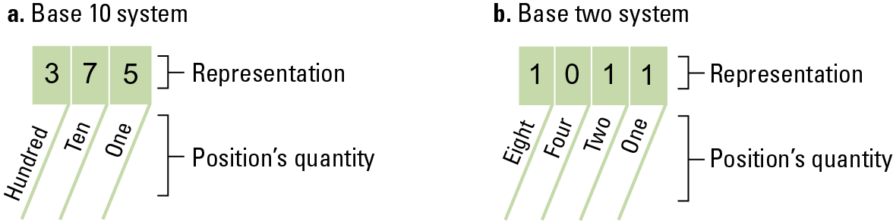
The base ten and binary systems

Slide 37
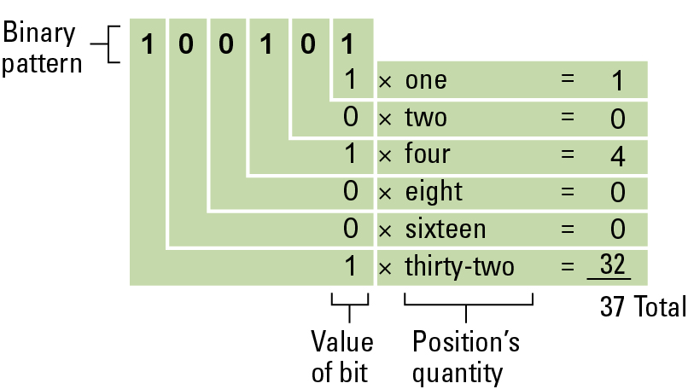
Decoding the binary representation 100101

Slide 38
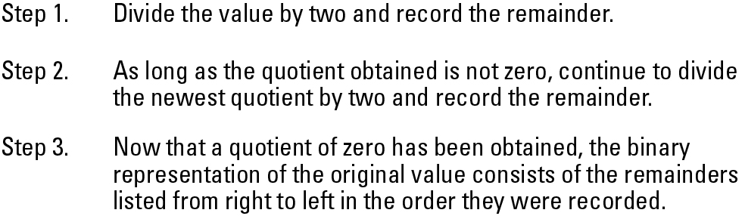
An algorithm for finding the binary representation of a positive integer

Slide 39
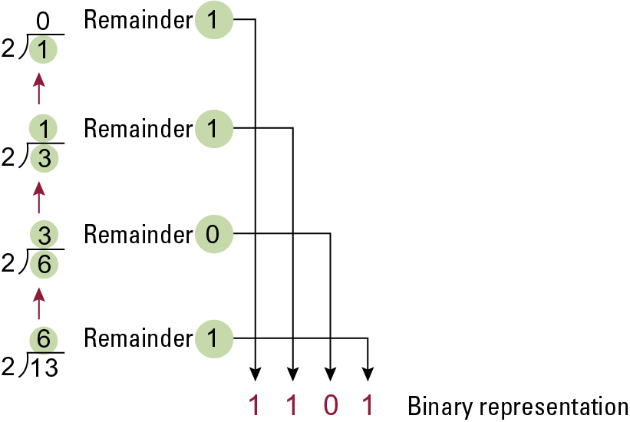
Applying the algorithm in previous slide to obtain the binary representation of 13

Slide 40
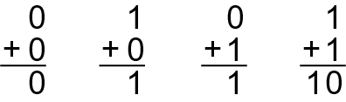
The binary addition facts

Slide 41
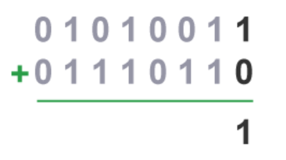
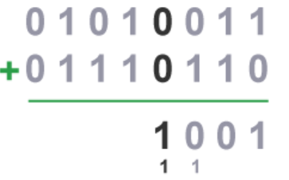
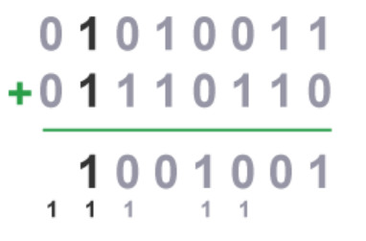
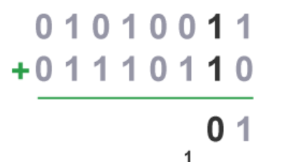
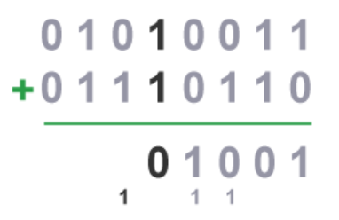
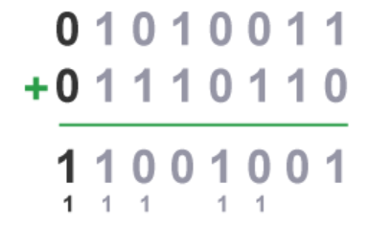
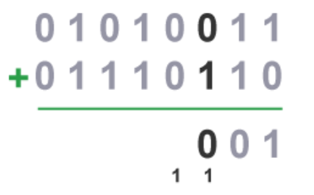
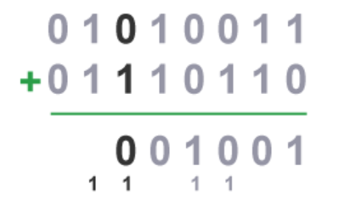
Binary Addition Step-by-Step
1)
4)
7)
2)
5)
8)
3)
6)

Slide 42
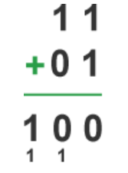
The Problem of Overflow
There is a limit to the size of values that can be represented in any system
Overflow
occurs when a computation produces a value that falls outside the range of values that can be represented in the machine
in this case, an overflow has occurred – leads to unpredictable results, sometimes a system crash error or sometimes incorrect result (in this case 3 + 1 = 0!)
16 bit/32 bit/64 bit systems – the more bits, the more precise in computation and more data values can be properly handled.
Lost
Bit

Slide 43
Storing Integers
Integers can be stored as signed or unsigned.
Signed – the MSB (left-most bit) indicates the sign
0 = positive number, 1 = negative number
Range of signed 8-bit numbers: -128 to 127
Unsigned – the MSB (left-most bit) is considered a value digit
all numbers are positive
Range of unsigned 8-bit numbers: 0 to 255
Two’s complement notation: The most popular means of representing signed integer values
Excess notation: Another means of representing signed integer values

Slide 44
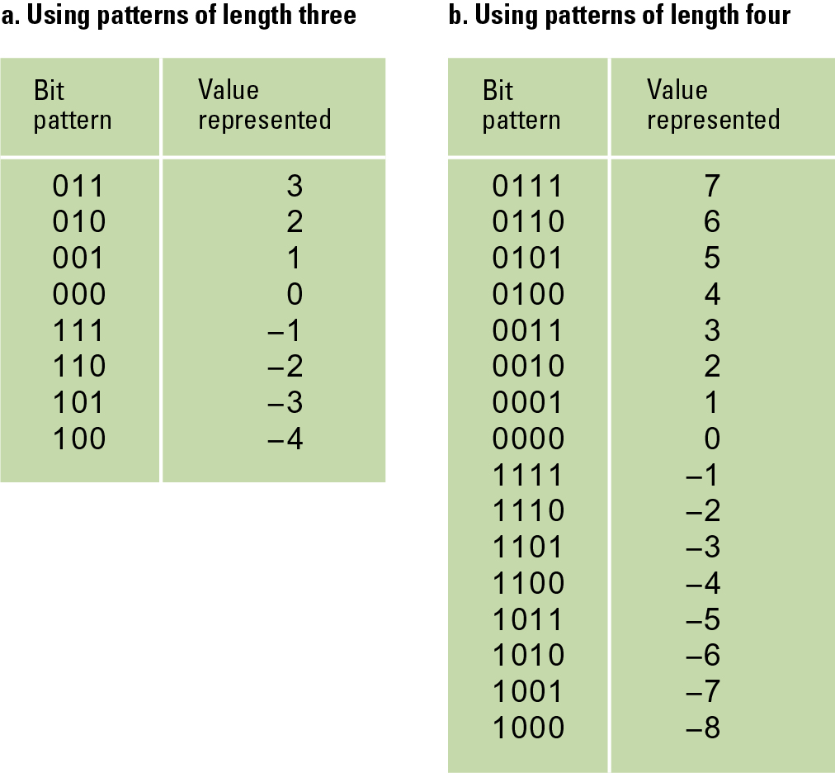
Two’s complement notation systems
Also, watch videos
“2’s complement, Part 1” and
“2’s complement, Part 2” attached to this lesson.

Slide 45
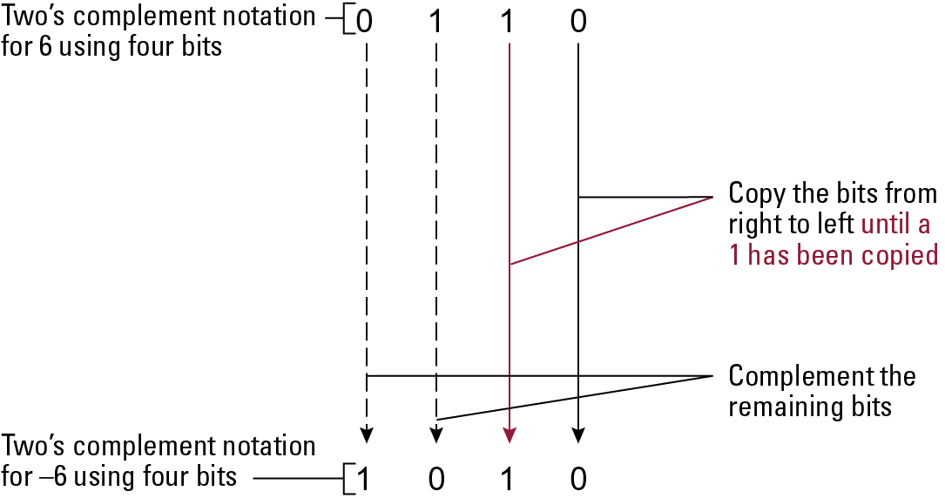
Coding the value -6 in two’s complement notation using four bits
Method 1:
Copy the bits from right to left until a 1 has been copied, then complement (flip) the remaining bits

Slide 46
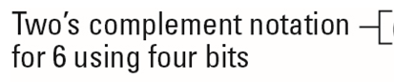
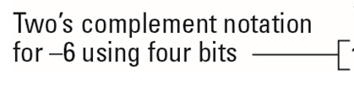
Coding the value -6 in two’s complement notation using four bits
0 1 1 0
1 0 0 1
1 0 1 0
Method 2:
Complement (flip/invert) all bits, and then add the value of 1 to the result.
Complement all bits
Add value of 1 to the result

Slide 47
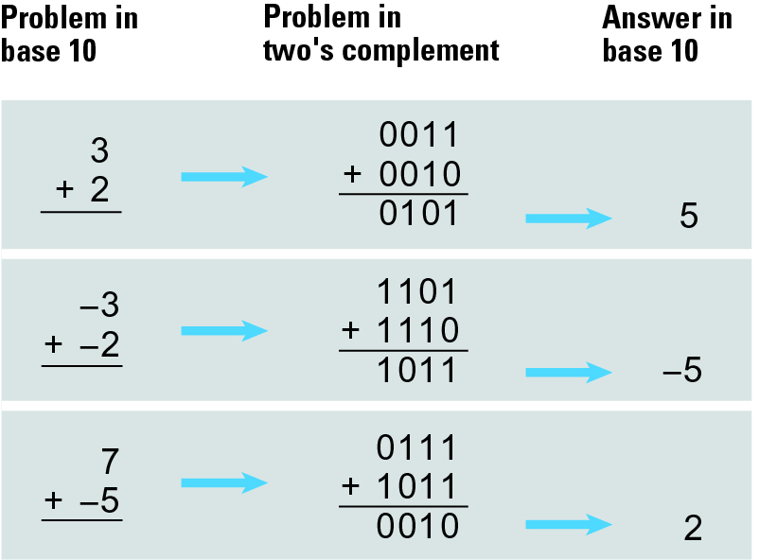
Addition problems converted to two’s complement notation

Slide 48
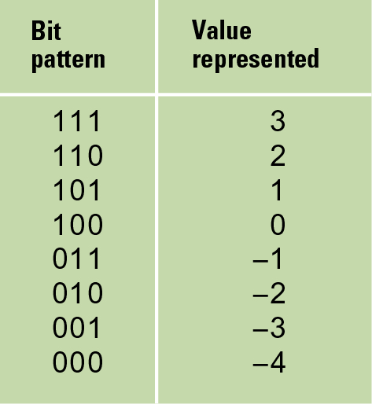
An excess notation system using bit patterns of length three
Excess notation:
Another form of representing signed numeric values in binary.
Similar to two’s complement, MSB is the sign bit.
However, sign bit is opposite of what it is for two’s complement:
1 – Positive
0 – Negative

Slide 49
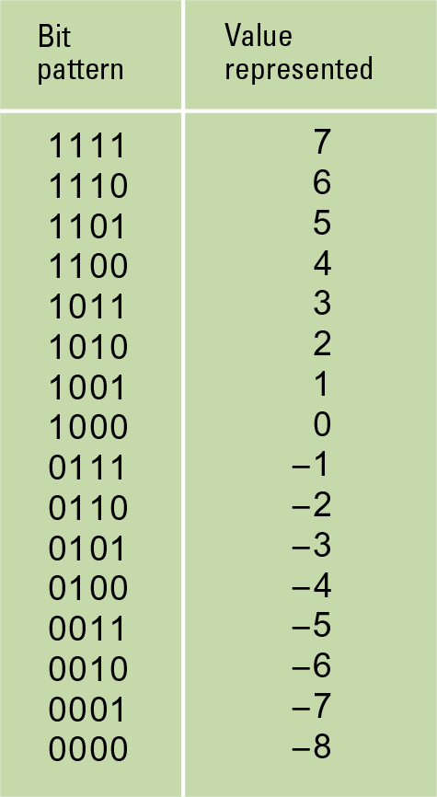
An excess eight conversion table
Conversion from binary to excess notation:
0110
The MSB is the 8s column (also called the “excess column”).
Find the sum value of the entire pattern as though it were a standard binary number:
(0x8) + (1x4) + (1x2) + (0x1)
= 0 + 4 + 2 + 0
= 6
Then subtract the “excess column”:
6 – 8
= -2

Slide 50
An excess eight conversion table
Conversion from decimal to excess notation:
6
Compute the “excess number” using the formula 2^{N-1} where N = # bit system used (in this case, 4)
2 ⁴⁻¹ = 2³ = 8
Add the “excess number” to the original decimal number and convert the result to unsigned binary: 6 + 8 = 14
What is 14 in 4-bit unsigned binary?
(1x8) + (1x4) + (1x2) + (0x1)
= 1110

Slide 51
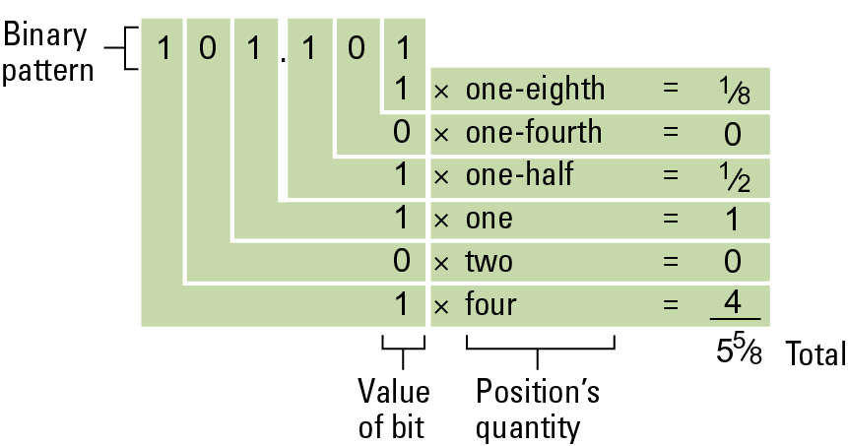
Storing Fractions

Slide 52
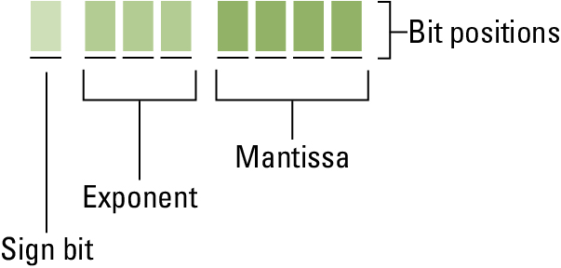
Using Floating-Point Notation
Floating-point Notation: Consists of a sign bit, a mantissa field, and an exponent field.
Normalized form: fill the mantissa starting with the left-most 1
Decimal number:
1202.234
Scientific Notation:
1.202234 x 10³
Mantissa
Exponent

Slide 53
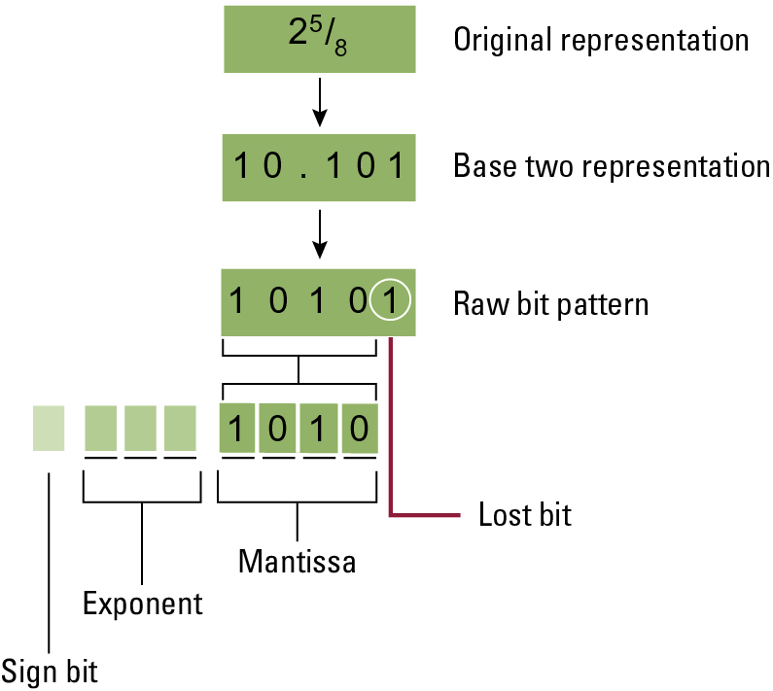
Encoding the value 2 ⁵⁄₈ (2.625) in IEEE754 Floating Point Notation (IEEE = Institute of Electrical and Electronic Engineers)
Represent floating point in binary form.
Represent the binary form in scientific notation.
Writing scientific notation in IEEE754 floating point notation.
Watch Floating Point Notation Video for
step-by-step example.

Slide 54
Truncation (Round-off) Errors
Occur when part of the value being stored is lost because the mantissa is not large enough
Non-terminating expansions of fractions
This happens more often with binary notation
The value of one-tenth cannot be stored exactly binary notation
Often these values are converted to integers

